Slide 1

Water Potability
Prediction Analysis
“In the domain of Water Quality Assessment, The project aims to develop a machine learning model to predict water potability based on various water quality parameters. This model will help in assessing whether water is safe for consumption, which is crucial for public health and water management.”
Presented By: Milan Virash

Slide 2
Objectives :
Explore the Dataset: Uncover patterns, distributions, and relationships within the data.
Conduct Extensive Exploratory Data Analysis (EDA): Dive deep into univariate and bivariate relationships against the target.
Preprocessing Steps:
Address missing values
Treat outliers
Encode categorical variables
Transform skewed features to achieve normal-like distributions
Model Building:
Establish models
Implement and tune classification models including Logistic Regression, SVM, Decision Trees, Random Forest and KNN
Emphasize achieving high recall for class 1, ensuring comprehensive identification potability
Evaluate and Compare Model Performance: Utilize precision, recall, and F1-score to gauge models' effectiveness.

Slide 3

WorkFlow:
1
Introduction
2
Question
3
Dataset Overview
4
EDA
5
PreProcessing
6
Model Training
7
Model Selection
8
Conclusion

Slide 4
1
Introduction
• In this project, the aim is to develop a machine learning model to predict water potability based on various water quality parameters. This model will help in assessing whether water is safe for consumption, which is crucial for public health and water management.
• Global Access to Safe Drinking Water: According to the World Health Organization (WHO), 2 billion people globally lack access to safely managed drinking water services. Contaminated water can carry diseases like cholera, diarrhea, and typhoid, leading to serious health risks.
• Waterborne Diseases: In low- and middle-income countries, around 485,000 deaths annually are attributed to diarrhea caused by unsafe drinking water, according to WHO reports.
• Heavy Metals: The presence of heavy metals (like lead and mercury) in drinking water poses serious long-term health risks. For instance, the Flint water crisis in the U.S. highlighted how lead contamination can cause developmental issues in children.
• Water Filtration and Treatment: Improved water filtration systems and treatment can prevent about 2 million deaths from water-related diseases annually.

Slide 5

2
Question
• Is the water potable or not?

Slide 6

3
Dataset Overview
3676 Rows
Dataset
10 Columns
Features
(columns)
Ph, Hardness, Solids,
Chloramines, Sulfate,
Conductivity, Organic
Carbon, Trihalomethanes,
Turbidity
X
Input Features
1 = Potable
Y
Output Variable
Potability
0 = Not Potable

Slide 7
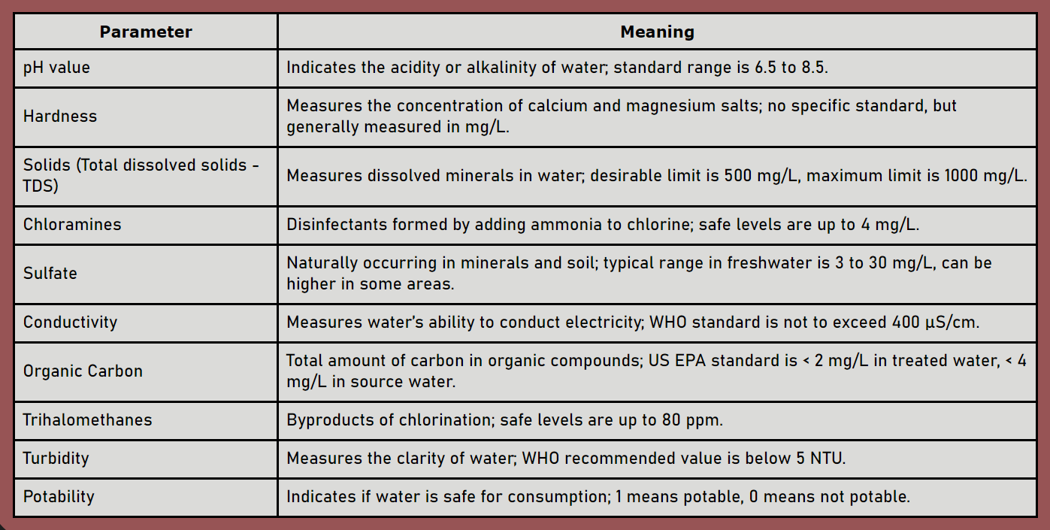
• All the columns given in the dataset are water components. Which I have tried to briefly introduce here in the table.

Slide 8
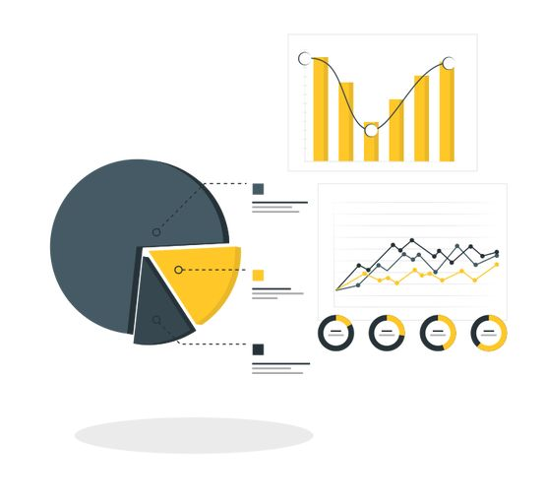

4
EDA
For Exploratory Data Analysis (EDA), we'll take it in two main steps:
Univariate Analysis:
Here, we'll focus on one feature at a time to understand distribution and range.
2. Bivariate Analysis:
In this step, we'll explore the relationship between each feature and the target variable. This helps us figure out the importance and influence of each feature on the target outcome.
With these two steps, we aim to gain insights into the individual characteristics of the data and also how each feature relates to our main goal: predicting the target variable.

Slide 9
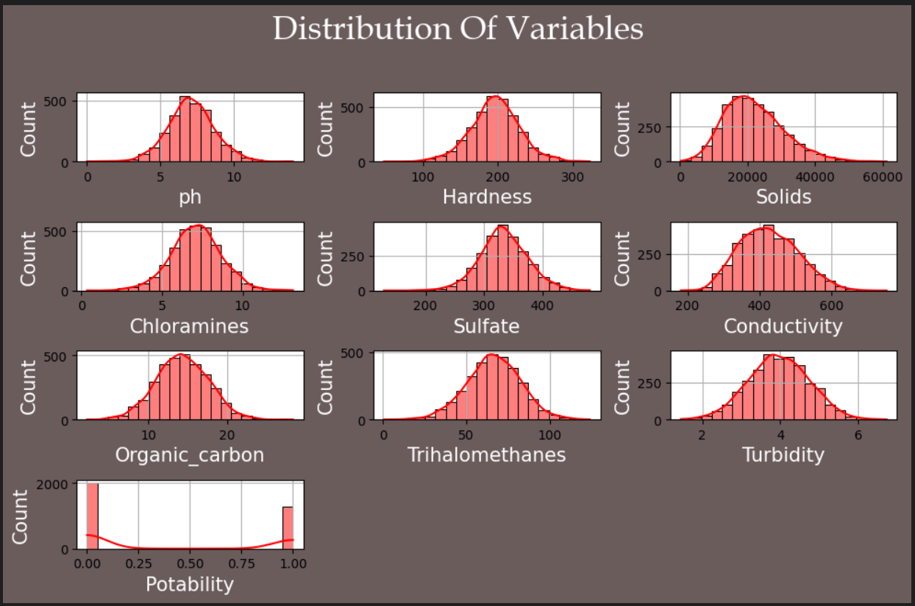
Univariate Analysis :
● All features have a very similar distribution of their values.
● In addition, they all show a very gaussian form so there is no need to normalize any feature.
● However here I have applied some algorithms (tree based algorithms) which require normalization or standardization so I have standardize the data further.

Slide 10
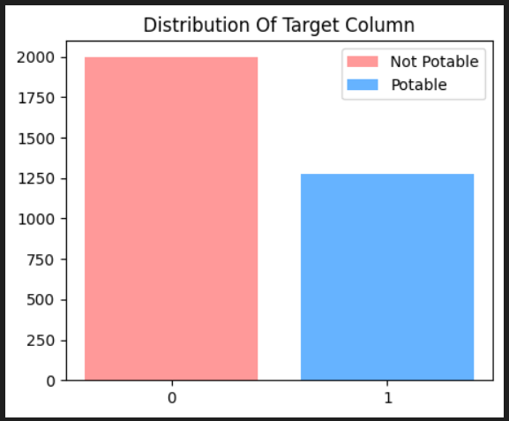
Distribution Of Target Column
● Explanation Visualization Purpose: The plot shows the count of each class (0 = Not Potable, 1 = Potable) in the dataset, allowing you to quickly assess whether the classes are balanced or imbalanced.
● Balanced vs. Imbalanced Data: A balanced dataset has an equal number of instances for each class, while an imbalanced dataset has a significant disparity between classes. Understanding this distribution is crucial, as an imbalanced dataset might require special handling to ensure the model is not biased towards the majority class.

Slide 11
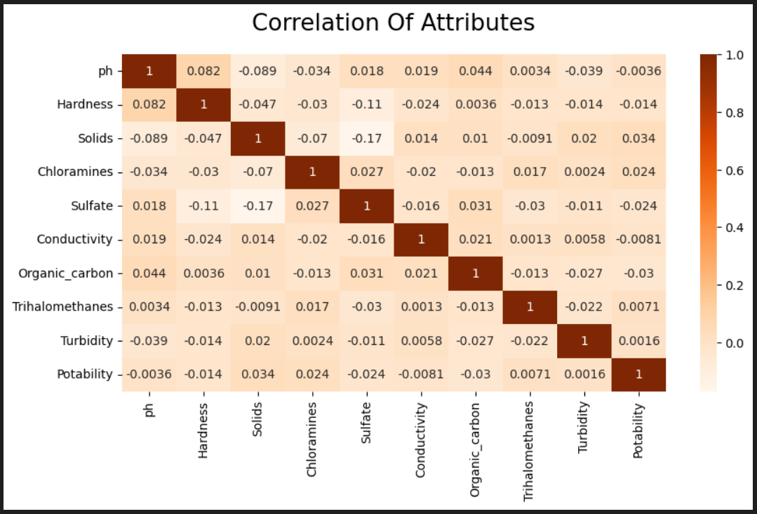
Bivariate Analysis :
● No strong positive correlations exist between any variables and water potability.
● Sulfate, Trihalomethanes, and Conductivity show moderate negative correlations with potability.
● Factors like pH, Hardness, Solids, Chloramines, Organic_carbon, and Turbidity have weak or negligible correlations with potability.

Slide 12

5
PreProcessing
● Irrelevant Feature Removal:
All features in the dataset appears to be relevant based on EDA. We will retain all the columns, ensuring no valuable information is lost, especially given the dataset’s small size.
● Missing Value Treatment:
Since our dataset is already small, removing rows with missing values would reduce its size even further. Therefore, I have filled the missing values with the mean of each field for both categories.
● Outlier Treatment:
our dataset is already small, if we remove the outliers, it will get even smaller. So I did not remove OUTLIERS but replace it with lower/upper whiskers.
● SMOTE for make the data balanced:
Our data is so imbalanced. So I applied the SMOTE method to make it balanced

Slide 13
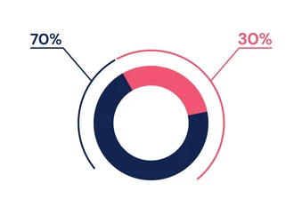
● Splitting The Data Into X & Y:
● We divide the dataset into two parts: X and Y.
“X” typically represents the Independent variables, and
“Y” represents the Dependent (target variable) that we want to predict or understand
Training
Data
Testing
Data
● Train Test Split:
● We divide the data into training(70%) and testing(30%) sets.
Setting a random state ensures consistent results and stratify=Y maintains a proportional distribution of the target variable in both sets.

Slide 14
6
Model Training
● Model Used:
Logistic Regression: logistic Regression is commonly used for binary classification problems. it's preferred because it provides a simple an efficient way to model the relationship between the independent variables and the probability of a certain outcome.
Decision Tree: Decision Tree algorithms are used for classification because they are simple, computationally efficient, and effective in handling high-dimensional dataWorks best for categorical independent columns.
Random Forest Algorithm: Random Forest: Random Forest is a robust supervised algorithm suitable for both regression and classification tasks.
Support Vector Machine: SVM is a powerful supervised algorithm that works best on smaller datasets but on complex ones. Support Vector Machine(SVM)can be used for both regression and classification tasks, but generally, they work best in classification problems.
K nearest Neighbours(KNN): KNN is a versatile algorithm used for classification, especially when data lacks a clear boundary. It works by considering the k nearest neighbors to a data point and classifying it based on their majority class.
XGBoost: XGBoost is an optimized distributed gradient boosting library designed for efficient and scalable training of machine learning models.

Slide 15
7
Model Selection
● Model Comparison:
Model | Accuracy | Precision | Recall | F1-Score
Logistic Regression | 0.60 | 1.00 | 0.01 | 0.02
Decision Tree | 0.73 | 0.73 | 0.53 | 0.61
Random Forest | 0.76 | 0.89 | 0.46 | 0.61
SVM | 0.59 | 0.00 | 0.00 | 0.00
KNN | 0.55 | 0.43 | 0.28 | 0.34
XGBoost | 0.77 | 0.74 | 0.67 | 0.71
● Understanding:
● Accuracy: The accuracy of the model when it claims to have found something.
● Precision: it refers to the quality of being exact and accurate.
● Recall: The ability of a model to find all the relevant cases.
● F1-Score: A balance between recall and precision, useful when both false positives and false negatives need to be minimized.

Slide 16
● Best Model: Random Forest
● Reason: Random Forest achieved a testing accuracy of 0.76, which is higher than most other models except XGBoost (which has an accuracy of 0.77). Random Forest has a good balance between testing precision (0.89) and recall (0.46).
● Why Other Models Are Not Best?:
● Logistic Regression and SVM: Both Logistic Regression and SVM have significantly lower scores across all testing metrics (accuracy, precision, recall, and F1-score). These models may not generalize well to unseen data.
● Decision Tree: Decision Tree has a higher training accuracy but lower testing accuracy compared to Random Forest. This discrepancy suggests overfitting—the model performs well on the training data but poorly on unseen data.
● KNN: KNN has perfect training accuracy but poor testing metrics (precision, recall, and F1-score).Again, this indicates overfitting, as the model memorizes the training data rather than learning general patterns.
● XGBoost: XGBoost has slightly better accuracy (0.77) than Random Forest (0.76). However, its precision (0.89) is slightly lower than Random Forest, which may impact its performance in specific scenarios.

Slide 17
8
Conclusion
Various machine learning algorithms were applied to predict water potability based on the given dataset.
The models tested include Logistic Regression, Decision Tree, Random Forest, SVM, KNN classifiers and XGBoost.
Among these, the Random Forest classifier demonstrated the highest performance in terms of accuracy and robustness. This suggests that Random Forest is particularly effective in capturing the complex relationships within the data, making it a suitable choice for this classification task.
The superior performance of Random Forest highlights its capability to handle the nuances of water quality prediction, which could be vital for ensuring safe and reliable water sources.
● Future Work:
Future work could explore further optimization of the Random Forest model or the integration of additional features to enhance predictive accuracy.

Slide 18

Thank You

